Slide 1

Database Development and Design
Developing and Design of databases using PostgreSQL - Powerful, open-source object-relational database

Slide 2
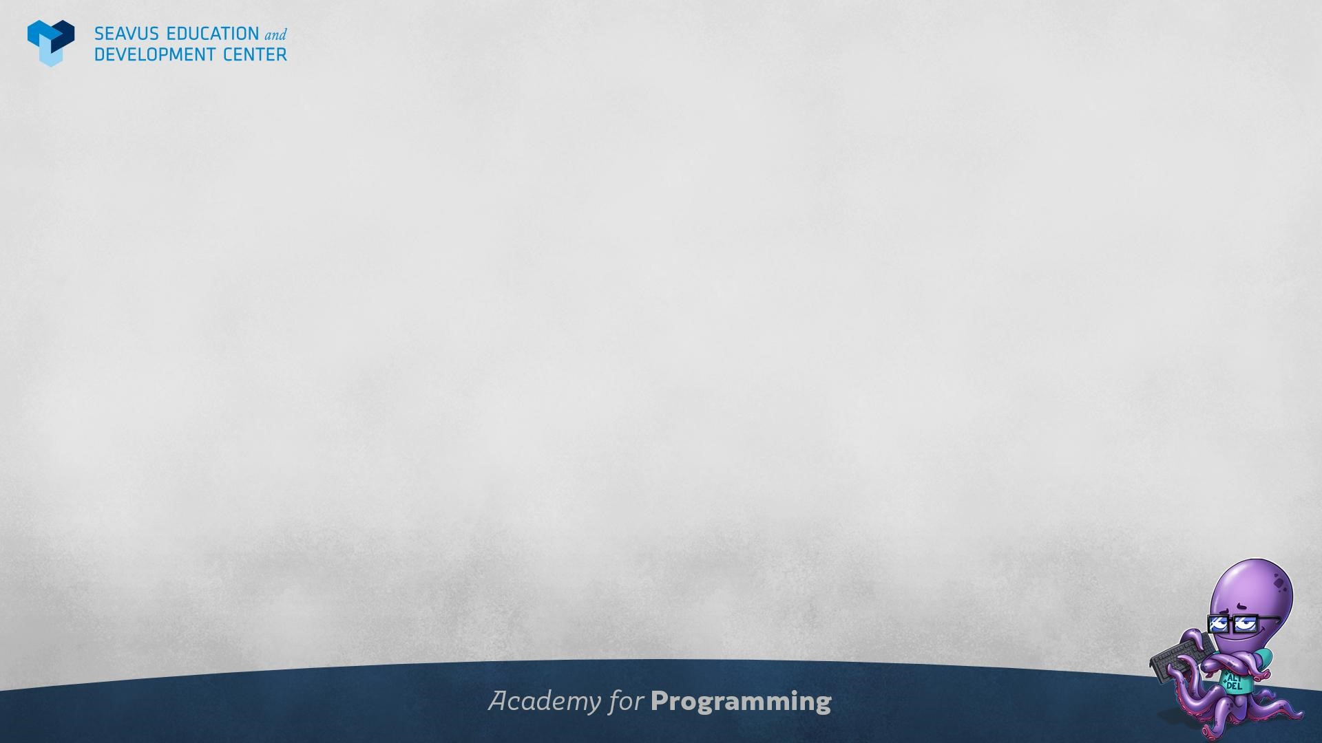

About me
Education
Bachelor’s degree – College of Telecommunication
and Post - Sofia (2002-2006)
Working experience
Seavus Group ( 2017 – Ongoing)
TabTale (Matrix Global) (2016-2017)
Aspekt (2010-2016)
Current job position
Senior Database Developer
Contact details:
edijan.jasharovski@seavus.com
edijan.jasharovski@gmail.com
Linkedin:
https://www.linkedin.com/in/edijan-jasharovski-82465836/

Slide 3
Major course intro
Understanding the Core Database Concepts
Database Server, Database, Data Types, DDL, DML
INSERT, UPDATE, DELETE
Querying data
Select statements, Filtering, Sorting, Unions, Joins
Foreign keys
Advanced querying
Aggregate functions, Grouping data, Views
Database routines
Stored procedures, Functions
Error handling and Basic Administration
Triggers and Constraints, Error handling
Users, Permissions, Roles

Slide 4
Agenda
Session 1
Database concepts and usage
Types of databases
Introduction to pgAdmin 4
Key terminology (DDL and DML statements)
Demo 1 - DDL and DML
Data types
Demo 2 – Data types
CRUD Operations (Create, Read, Update, Delete)
Create, Insert, Update, Delete
Workshop – Creating tables
Knowledge check (Quiz, Discussion, Homework)
Session 2
Session 3
Session 4
Session 5
Session 6
Session 7

Slide 5
Session 1

Slide 6
Database concepts and usage

Slide 7
Database definitions 1/2
Cambridge dictionary
A large amount of information stored in a computer system in such a way that it can be easily looked at or changed.
Wikipedia
Database is an organized collection of data, generally stored and accessed electronically from a computer system. Where databases are more complex, they are often developed using formal design and modeling techniques.
Britannica
Database, also called electronic database, any collection of data, or information, that is specially organized for rapid search and retrieval by a computer. Databases are structured to facilitate the storage, retrieval, modification, and deletion of data in conjunction with various data-processing operations.

Slide 8
Database definitions 2/2
A database consists of logically related data stored in a single repository.
Provides advantages over file system management approach
Eliminates inconsistency, data anomalies, data dependency, and structural dependency problems
It stores data structures, relationships, and access paths

Slide 9
Example of an old traditional database application
Suppose we are building a system to store the information about:
Customers
Products
Orders
Can we do it without a database management system (DBMS)?
We can if we store the data in files
Customer.txt Product.txt Order.txt

Slide 10
Database management system (DBMS)
A database management system (DBMS) is a software package designed to define, manipulate, retrieve and manage data in a database.
A DBMS generally manipulates the data itself, the data format, field names, record structure and file structure.
It also defines rules to validate and manipulate this data.

Slide 11
Doing it without DBMS
Suppose we need to create a program to execute specific tasks with the data about customers, products and orders
Perform an order: “Customer A” orders “Product A”
Write a program to do the following:
Read ‘Customer.txt’
Read ‘Product.txt’
Write in ‘Orders.txt’ - “Customer A orders Product A”
Write in “Product.txt” - “Product A” has changed available quantity

Slide 12
Problems without DBMS
Large data sets (Millions of Customers and Products)
Creates problem with memory
Concurrent access by many users
Multiple users want to place an order in a same time. Multiple requests for write to Orders data file.
Data inconsistency
Data inconsistency occurs when different versions of the same data exist in different places in an organization.
A management system helps get quick solutions to database queries, thus making data access faster and more accurate. End-users like salespeople will have enhanced access to the data, enabling more productivity.

Slide 13
Importance of DBMS
Makes data management more efficient and effective
Query language allows quick answers to ad hoc queries
Provides better access to more and better-managed data
Promotes integrated view of organization’s operations
Reduces the probability of inconsistent data

Slide 14
PostgreSQL
PostgreSQL is an advanced, enterprise-class, and open-source relational database system. PostgreSQL supports both SQL (relational) and JSON (non-relational) querying.
PostgreSQL is a highly stable database backed by more than 20 years of development by the open-source community.
PostgreSQL is used as a primary database for many web applications as well as mobile and analytics applications.

Slide 15
Types of databases

Slide 16
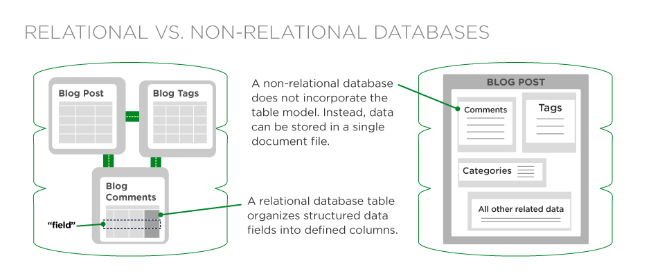
Types of databases 1/3
Relational databases (SQL)
Non-Relational databases (NoSQL)

Slide 17
Types of databases 2/3
SQL | NoSQL
RELATIONAL DATABASE MANAGEMENT SYSTEM (RDBMS) | Non-relational or distributed database system
These databases have fixed or static or predefined schema | They have dynamic schema
These databases are not suited for hierarchical data storage | These databases are best suited for hierarchical data storage.
These databases are best suited for complex queries | These databases are not so good for complex queries
Vertically Scalable | Horizontally scalable

Slide 18
Types of databases 3/3
Relational databases (SQL)
Structured (table based)
Most popular
SQL Server, Oracle, PostgreSQL, MySQL
Non-Relational databases (SQL)
Non structured
Document based
Key-value pairs
Graph databases
Wide column stores
Most popular
MongoDB, Cassandra, Hbase, CoachDB

Slide 19
Introduction to pgAdmin 4

Slide 20
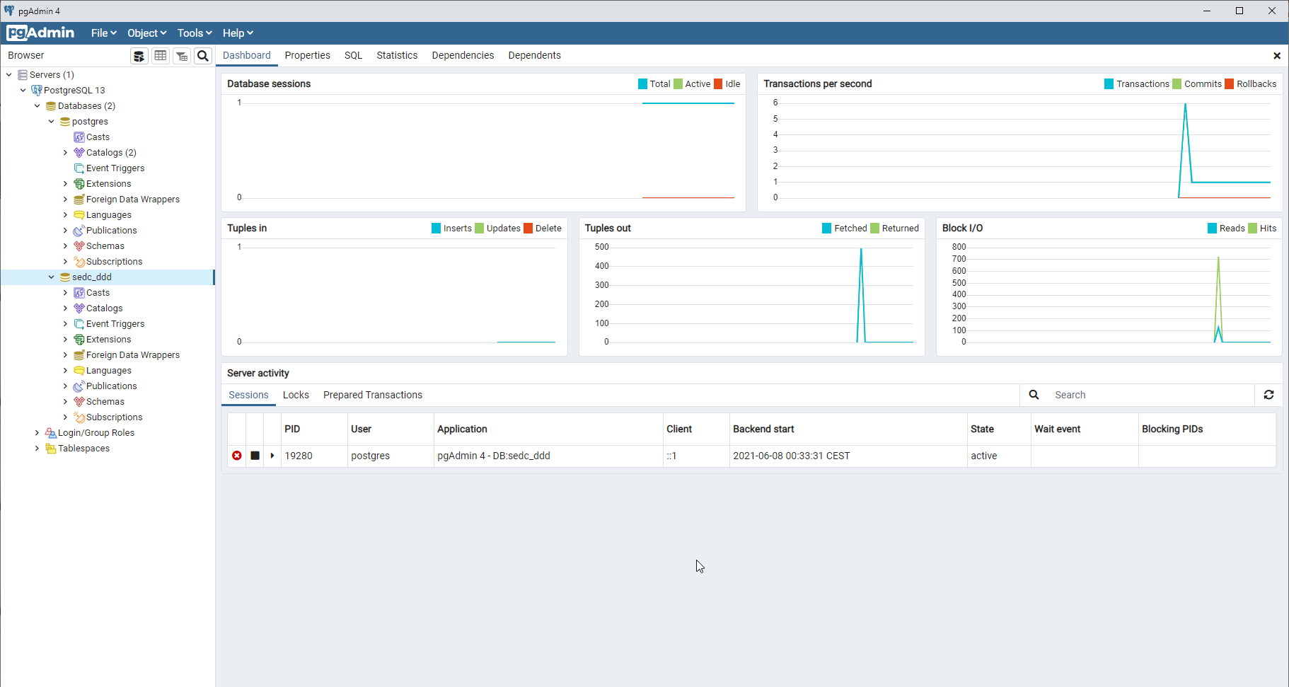

Slide 21
Key terminology

Slide 22
Key database terminology 1/2
Data Definition Language (DDL) is a subset of the Transact-SQL language; it deals with creating database objects like tables, constraints, and stored procedures. The interface used to create these underlying DDL statements is the pgAdmin user interface.
The main DDL statements are as follows:
ALTER
CREATE
DROP
GRANT
REVOKE

Slide 23
Key database terminology 2/2
Data Manipulation Language (DML) is the language element that allows you to use the core statements INSERT, UPDATE and DELETE to manipulate data in any SQL Server tables. Core DML statements include the following:
SELECT: Retrieves rows from the database and enables the selection of one or many rows or columns from one or many tables in SQL Server.
INSERT: Adds one or more new rows to a table or a view in SQL Server.
UPDATE: Changes existing data in one or more columns in a table or view.
DELETE: Removes rows from a table or view.

Slide 24
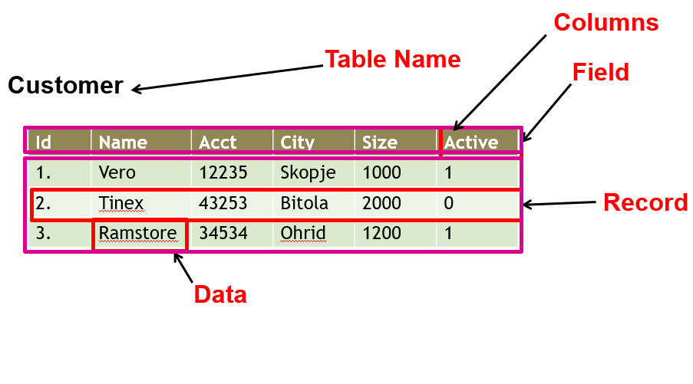
A table example terminology
A table is a collection of related data held in a table format within a database. It consists of columns and rows.

Slide 25
Demo 1 - DDL and DML

Slide 26
Demo 1 - DDL and DML
Session 1 – 01 Create table.xlsx
Session 1 – 02 DDL and DML.sql

Slide 27
Data types in PostgreSQL

Slide 28
Data types in PostgreSQL
Each column in a database table is required to have a name and a data type.
SQL data type is an attribute that specifies type of data of any object. Each column, variable and expression has related data type in SQL.
You would use these data types while creating your tables. You would choose a particular data type for a table column based on your requirement.
SQL developers must decide what types of data will be stored inside each table column when creating a SQL table.
The data type is a label and a guideline for SQL to understand what type of data is expected inside of each column, and it also identifies how SQL will interact with the stored data.

Slide 29
Data types in PostgreSQL
In PostgreSQL, each column, local variable, expression, and parameter has a related data type. A data type is an attribute that specifies the type of data that the object can hold: Boolean, character, numeric, temporal, array, json, uuid, and special types.

Slide 30
Data types in PostgreSQL
Boolean
A Boolean data type can hold one of three possible values: true, false or null. You use boolean or bool keyword to declare a column with the Boolean data type.
Character
PostgreSQL provides three character data types: CHAR(n), VARCHAR(n), and TEXT
CHAR(n) is the fixed-length character with space padded. If you insert a string that is shorter than the length of the column, PostgreSQL pads spaces. If you insert a string that is longer than the length of the column, PostgreSQL will issue an error.
VARCHAR(n) is the variable-length character string. With VARCHAR(n), you can store up to n characters. PostgreSQL does not pad spaces when the stored string is shorter than the length of the column.
TEXT is the variable-length character string. Theoretically, text data is a character string with unlimited length.

Slide 31
Data types in PostgreSQL
Numeric
Integer
There are three kinds of integers in PostgreSQL:
Small integer (SMALLINT) is 2-byte signed integer that has a range from -32,768 to 32,767.
Integer (INT) is a 4-byte integer that has a range from -2,147,483,648 to 2,147,483,647.
Serial is the same as integer except that PostgreSQL will automatically generate and populate values into the SERIAL column. This is similar to AUTO_INCREMENT column in MySQL or AUTOINCREMENT column in SQLite.
Floating-point number
There three main types of floating-point numbers:
float(n) is a floating-point number whose precision, at least, n, up to a maximum of 8 bytes.
Real or float8 is a 4-byte floating-point number.
numeric or numeric(p,s) is a real number with p digits with s number after the decimal point. The numeric(p,s) is the exact number.

Slide 32
Data types in PostgreSQL
Temporal data types
The temporal data types allow you to store date and /or time data. PostgreSQL has five main temporal data types:
DATE stores the dates only.
TIME stores the time of day values.
TIMESTAMP stores both date and time values.
TIMESTAMPTZ is a time zone-aware timestamp data type. It is the abbreviation for timestamp with the time zone.
INTERVAL stores periods of time.

Slide 33
Data types in PostgreSQL
UUID for storing Universally Unique Identifiers
Array for storing array strings, numbers, etc.
JSON stores JSON data
hstore stores key-value pair
Special types such as network address and geometric data.

Slide 34
Demo 2 - Data types

Slide 35
CRUD operations
Create, Read, Update, Delete

Slide 36
CREATE operation 1/2
Create new data structure (Table, View, Function, Procedure, …)
Example:
CREATE TABLE TableName (
Column1_Name Data_type_1,
Column2_Name Data_type_2,
...
ColumnN_Name Data_type_N)
CREATE TABLE Customer (
Id INTEGER NOT NULL,
Name varchar(100) NOT NULL,
City varchar(100) NULL)

Slide 37
Create operation 2/2
Primary key concept
Short, Not changeable, Incremental, Unique
CREATE TABLE Customer (
Id INTEGER PRIMARY KEY,
Name TEXT,
Address TEXT);

Slide 38
INSERT operation
Insert new data
Example:
INSERT INTO TableName (Col1, Col2, ...)
VALUES (Value1, Value2, ...)
INSERT INTO Customer (Id, Name, City)
VALUES (1, 'Vero Skopje', 'Skopje')
INSERT INTO Customer (Id, Name, City)
VALUES (2, 'Vero Strumica', 'Strumica')

Slide 39
READ operation
Read all data in the table:
Read only specific columns:
Read specific columns and Rows:
SELECT * FROM Customer
SELECT Id, Name, City
FROM Customer
SELECT Id, Name, City
FROM Customer
WHERE City = 'Skopje'

Slide 40
UPDATE operation
Update data
Example:
UPDATE TableName
SET Col1 = NewValue, Col2 = NewValue2,...
WHERE ColN = oldValue
UPDATE Customer
SET Name = 'Vero Bitola', City = 'Bitola'
WHERE Name = 'Vero Skopje'

Slide 41
DELETE operation
Delete data
Example:
DELETE
FROM TableName
WHERE ColN = oldValue
DELETE
FROM Customer
WHERE Name = 'Vero Skopje'

Slide 42
Workshop – Creating tables

Slide 43
Creating tables by using T-SQL
Create new database: SEDC
Create the following tables:
BusinessEntity
Employee
Product
Customer
Order
OrderDetails
Try to insert data in the tables

Slide 44
Create table - BusinessEntity
Column name | Data type | Allow nulls
Id | Integer
Name | varchar(100) | ✓
Region | varchar(1000) | ✓
Zipcode | varchar(10) | ✓
Size | varchar(10) | ✓
CREATE TABLE BusinessEntity (
Id Integer PRIMARY KEY NOT NULL,
Name varchar(100) NULL,
Region varchar(1000) NULL,
Zipcode varchar(10) NULL,
Size varchar(10) NULL)

Slide 45
Create table - Employee
Column name | Data type | Allow nulls
Id | Integer
FirstName | varchar(100)
LastName | varchar(100)
DateOfBirth | Date | ✓
Gender | nchar(1) | ✓
HireDate | Date | ✓
NationalIdNumber | varchar(20) | ✓
CREATE TABLE Employee (
Id Integer PRIMARY KEY NOT NULL,
FirstName varchar(100) NOT NULL,
LastName varchar(100) NOT NULL,
DateOfBirth date NULL,
Gender nchar(1) NULL,
HireDate date NULL,
NationalIdNumber varchar(20) NULL)

Slide 46
Create table - Product
Column name | Data type | Allow nulls
Id | Integer
Code | varchar(50) | ✓
Name | varchar(100) | ✓
Description | varchar(5000) | ✓
Weight | float(2) | ✓
Price | float(2) | ✓
Cost | float(2) | ✓

Slide 47
Create table - Customer
Column name | Data type | Allow nulls
Id | Integer
Name | varchar(100) | ✓
AccountNumber | varchar(50) | ✓
City | varchar(50) | ✓
RegionName | varchar(50) | ✓
PhoneNumber | varchar(20) | ✓
IsActive | boolean | ✓

Slide 48
Create table - Order
Column name | Data type | Allow nulls
Id | Integer
OrderDate | Date | ✓
Status | SMALLINT | ✓
BusinessEntityId | Integer | ✓
CustomerId | Integer | ✓
EmployeeId | Integer | ✓
TotalPrice | float(2) | ✓
Comment | varchar(500) | ✓

Slide 49
Create table - OrderDetails
Column name | Data type | Allow nulls
Id | Integer
OrderId | Integer | ✓
ProductId | Integer | ✓
Quantity | Integer | ✓
Price | float(2) | ✓

Slide 50
Homework 1

Slide 51
SEDCHome – List of tables
Student
- ID
- FirstName
- LastName
- DateOfBirth
- EnrolledDate
- Gender
- NationalIDNumber
- StudentCardNumber
Course
- ID
- Name
- Credit
- AcademicYear
- Semester
Teacher
- ID
- FirstName
- LastName
- DateOfBirth
- AcademicRank
- HireDate
Grade
- ID
- StudentID
- CourseID
- TeacherID
- Grade
- Comment
- CreatedDate
GradeDetails
- ID
- GradeID
- AchievementTypeID
- AchievementPoints
- AchievementMaxPoints
- AchievementDate
AchievementType
- ID
- Name
- Description
- ParticipationRate

Slide 52
SEDCHome – Table example
Teacher
Column name | Data type | Allow nulls
Id | Integer
FirstName | varchar(20)
LastName | varchar(30)
DateOfBirth | date
AcademicRank | varchar(20)
HireDate | date

Slide 53
SEDCHome – Table example
Grade
Column name | Data type | Allow nulls
Id | Integer
StudentId | Integer
CourseId | Integer
TeacherId | Integer
Grade | smallint
Comment | varchar(100)
CreatedDate | date

Slide 54
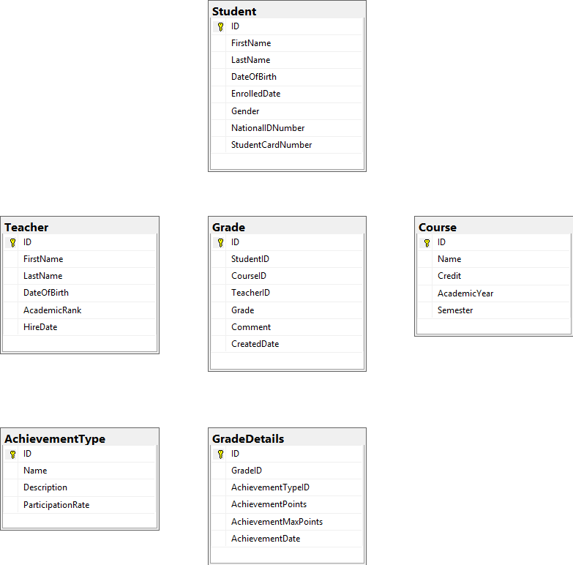
SEDCHome – schema

